Slide 1
UNIT 6 Create an Image Using FTK Imager
1
Notes:
On board:
preservation, collection, validation, identification, analysis, interpretation, documentation and presentation

Slide 2
FTK Imager
DISK CLONING: Cloning a hard drive during collection uses a target drive to
make an exact duplicate (bit stream copy) of the original hard drive. This process is normally completed using hardware referred to as hard drive cloning equipment.
The same capacity or Higher capacity is required
Can be used to retain the original and do the analysis on the cloned Disc.
2
Notes:
On board:
preservation, collection, validation, identification, analysis, interpretation, documentation and presentation

Slide 3
FTK Imager
DISK IMAGING: Imaging a hard drive is a phrase that is commonly used for
preserving the contents of a custodian hard drive or server.
It can also be used to describe when a custodian hard drive is cloned.
In this process Data is Saved as Disk to File as (.DD. EO1, RAW)
More the one cases can be saved on single Hard Drive
3
Notes:
On board:
preservation, collection, validation, identification, analysis, interpretation, documentation and presentation

Slide 4
FTK Imager
To create an image, select Create Disk Image from the File menu.
Source Evidence Type: To image an entire device, select Physical Drive (a physical device can contain more than one Logical Drive).
You can also create an image of an Image File, which seems silly, but it could be desirable if, say, you want to create a more compressed version of the image.
4
Notes:
On board:
preservation, collection, validation, identification, analysis, interpretation, documentation and presentation

Slide 5
FTK Imager
Case1: Open any connected partition cut/copy and paste the data to your drive
Case2: Show hidden files and folders then cut/copy and paste the data to your drive
Case3: To retrieve data from logical unallocated drives as well : Need to use a software tool FTK imager
5
Notes:
On board:
preservation, collection, validation, identification, analysis, interpretation, documentation and presentation

Slide 6
FTK Imager
A Physical Drive is the primary storage hardware or component within a device, which stores, retrieves, and organizes data.
A Logical Drive is generally a drive space that is created over a physical hard disk. A logical drive has its parameters and functions because it operates independently.
Logical : partitions
6
Notes:
On board:
preservation, collection, validation, identification, analysis, interpretation, documentation and presentation

Slide 7
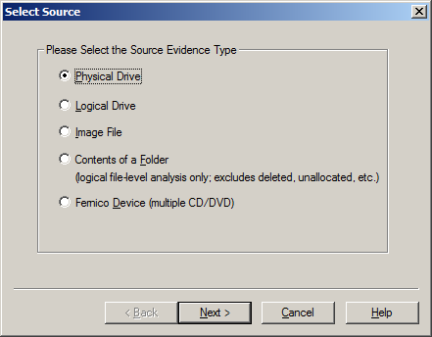
FTK Imager
7
Notes:
On board:
preservation, collection, validation, identification, analysis, interpretation, documentation and presentation

Slide 8
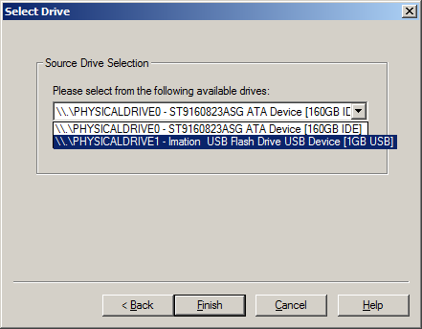
FTK Imager
Source Drive Selection: Based on our selection of physical drive, we select the drive corresponding to the pen drive.
8
Notes:
On board:
preservation, collection, validation, identification, analysis, interpretation, documentation and presentation

Slide 9
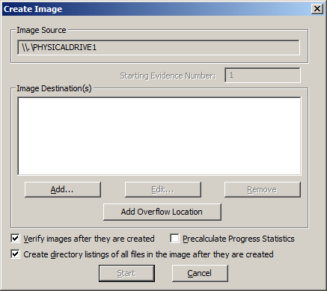
Create Image: Here is, where you can specify where the image will be created. We also always choose Verify images after they are created as a way to run a hash value check on the image file.
You can also Create directory listings of all files in the image after they are created, but be prepared that this will be a huge listing for a typical hard drive with hundreds of thousands of entries.
9
Notes:
On board:
preservation, collection, validation, identification, analysis, interpretation, documentation and presentation

Slide 10
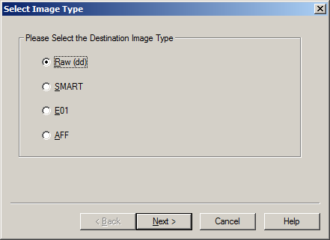
Select Image Type: This indicates the type of image file that will be created – Raw is a bit-by-bit uncompressed copy of the original, while the other three alternatives are designed for use with a specific forensics program.
We typically use Raw or E01, which is an EnCase forensic image file format.
10
Notes:
On board:
preservation, collection, validation, identification, analysis, interpretation, documentation and presentation

Slide 11
The different formats for creating the image are:
Raw(dd): It is a bit-by-bit copy of the original evidence which is created without any additions and or deletions. They do not contain any metadata.
SMART: It is an image format that was used for Linux which is not popularly used anymore.
E01: It stands for EnCase Evidence File, which is a commonly used format for imaging
AFF: It stands for Advanced Forensic Format which is an open-source format type.
11
Notes:
On board:
preservation, collection, validation, identification, analysis, interpretation, documentation and presentation

Slide 12
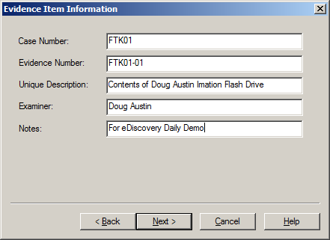
Evidence Item Information:
This is where you can enter key information about the evidence item you are about to create to aid in documenting the item.
This information will be saved as part of the image summary information once the image is complete.
12
Notes:
On board:
preservation, collection, validation, identification, analysis, interpretation, documentation and presentation

Slide 13
Select Image Destination:
We’ll browse to a folder that I have called “FTKImage” on the D: drive and give the image a file name.
Image Fragment Size indicates the size of each fragment when you want to break a larger image file into multiple parts.
Compression indicates the level of compression of the image file, from 0 (no compression) to 9 (maximum compression – and a slower image creation process).
13
Notes:
On board:
preservation, collection, validation, identification, analysis, interpretation, documentation and presentation

Slide 14
Select Image Destination:
For Raw uncompressed images, compression is always 0.
Using AD Encryption indicates whether to encrypt the image – we don’t typically select that, instead choosing to put an image on an encrypted drive (when encryption is desired).
Click Finish to begin the image process and a dialog will be displayed throughout the image creation process.
Because it is a bit-by-bit image of the device, it will take the same amount of time regardless of how many files are currently stored on the device.
14
Notes:
On board:
preservation, collection, validation, identification, analysis, interpretation, documentation and presentation

Slide 15
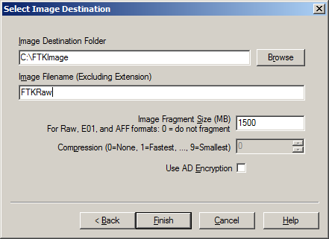
Select Image Destination:
15
Notes:
On board:
preservation, collection, validation, identification, analysis, interpretation, documentation and presentation

Slide 16
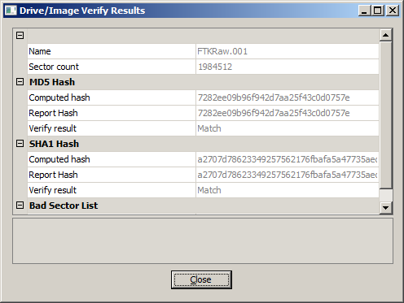
Drive/Image Verify Results: When the image is complete, this popup window will appear to show the name of the image file, the sector count, computed (before image creation) and reported (after image creation) MD5 and SHA1 hash values with a confirmation that they match and a list of bad sectors (if any).
The hash verification is a key check to ensure a valid image and the hash values should be the same regardless of which image type you create.
16
Notes:
On board:
preservation, collection, validation, identification, analysis, interpretation, documentation and presentation

Slide 17
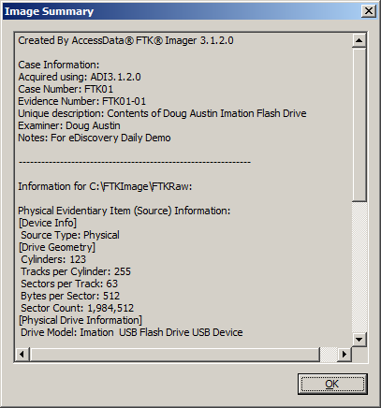
Image Summary: When the image is complete, click the Image Summary button to see a summary of the image that is created, including the evidence item information you entered, drive information, hash verification information, etc.
This information is also saved as a text file.
17
Notes:
On board:
preservation, collection, validation, identification, analysis, interpretation, documentation and presentation

Slide 18
Directory Listing: If you selected Create directory listings of all files in the image, the results will be stored in a CSV file, which can be opened with Excel.
And, there you have it – a bit-by-bit image of the device! You’ve just captured everything on the device, including deleted files and slack space data.
Check the destination folder where the image has been created.
It contains entire image information.
Segment details
18
Notes:
On board:
preservation, collection, validation, identification, analysis, interpretation, documentation and presentation

Slide 19
Mount Image
Go to image → mount image → select first image segment from the folder
Mount type: Physical only { or can keep by default
Mount Method : Block device/ Read only
Click mount
Click my PC → manage → check additional physical disk has been added
At GUI also additional disk added with same content.
19
Notes:
On board:
preservation, collection, validation, identification, analysis, interpretation, documentation and presentation

Slide 20
At GUI also additional disk is added with the same content.
Open an additional drive → right click → no option for create or delete files
20
Notes:
On board:
preservation, collection, validation, identification, analysis, interpretation, documentation and presentation

Slide 21
Recover Data
21
Notes:
On board:
preservation, collection, validation, identification, analysis, interpretation, documentation and presentation

Slide 22
Capturing Memory
It is the method of capturing and dumping the contents of a volatile content into a non-volatile storage device to preserve it for further investigation.
A ram analysis can only be successfully conducted when the acquisition has been performed accurately without corrupting the image of the volatile memory.
22
Notes:
On board:
preservation, collection, validation, identification, analysis, interpretation, documentation and presentation

Slide 23
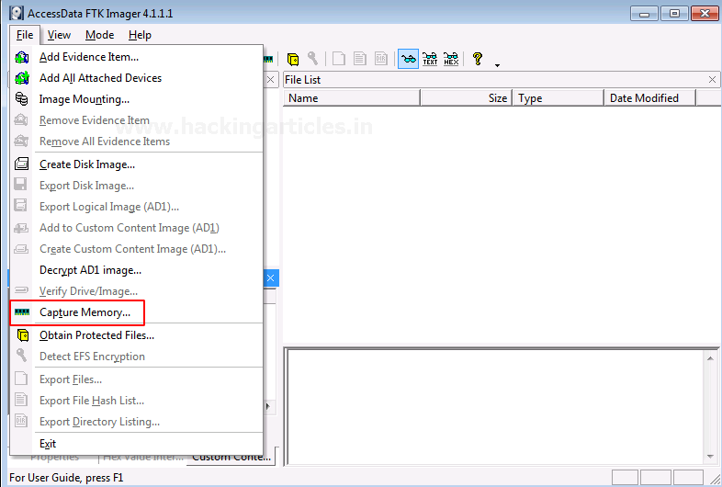
Capturing Memory
In this phase, the investigator has to be careful about his decisions to collect the volatile data as it won’t exist after the system undergoes a reboot.
To capture the memory, click on File > Capture Memory.
23
Notes:
On board:
preservation, collection, validation, identification, analysis, interpretation, documentation and presentation

Slide 24
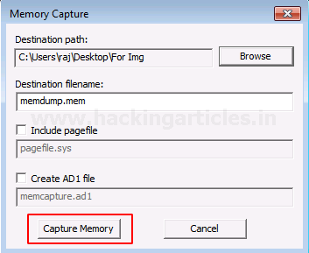
Capturing Memory
Choose the destination path and the destination file name, and click on capture memory.
24
Notes:
On board:
preservation, collection, validation, identification, analysis, interpretation, documentation and presentation

Slide 25
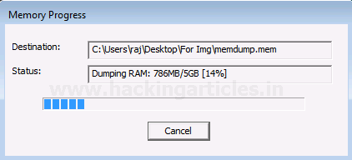
Capturing Memory
Now let us wait for a few minutes till the ram is being captured.
25
Notes:
On board:
preservation, collection, validation, identification, analysis, interpretation, documentation and presentation

Slide 26
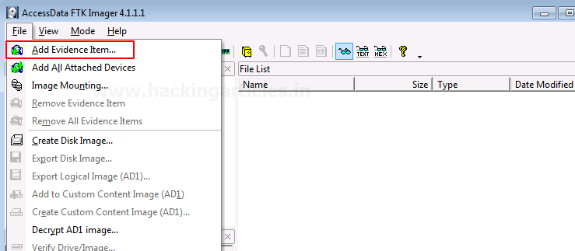
Analyzing Image Dump
Now let us analyze the Dump RAW Image once it has been acquired using FTK imager. To start with analysis, click on File> Add Evidence Item.
26
Notes:
On board:
preservation, collection, validation, identification, analysis, interpretation, documentation and presentation

Slide 27
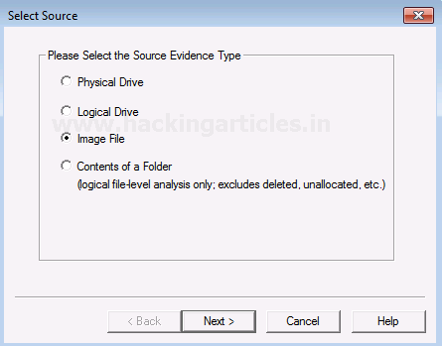
Analyzing Image Dump
Now select the source of the dump file that you have already created, so here you have to select the image file option and click on Next.
27
Notes:
On board:
preservation, collection, validation, identification, analysis, interpretation, documentation and presentation

Slide 28
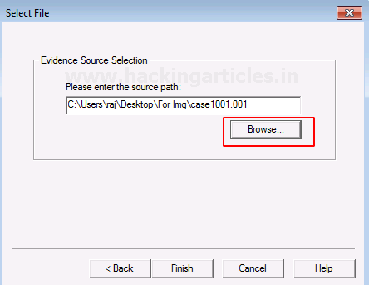
Analyzing Image Dump
Choose the path of the image dump that you have captured by clicking on Browse.
28
Notes:
On board:
preservation, collection, validation, identification, analysis, interpretation, documentation and presentation

Slide 29
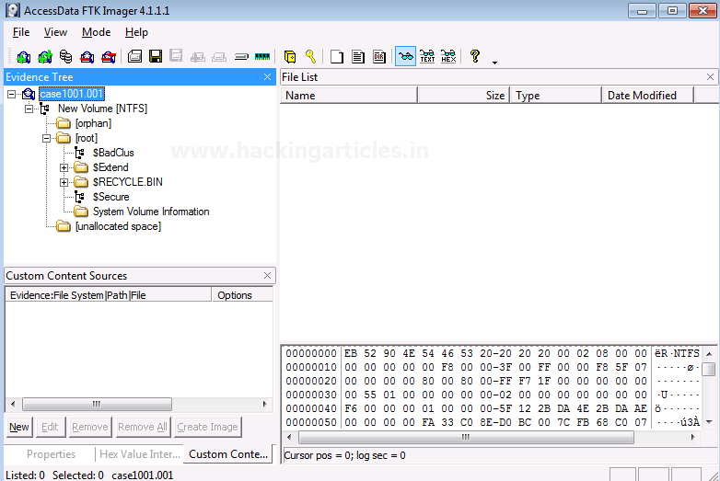
Analyzing Image Dump
Once the image dump is attached to the analysis part, you will see an evidence tree which has the contents of the files of the image dump. This could have deleted as well as overwritten data.
29
Notes:
On board:
preservation, collection, validation, identification, analysis, interpretation, documentation and presentation

Slide 30
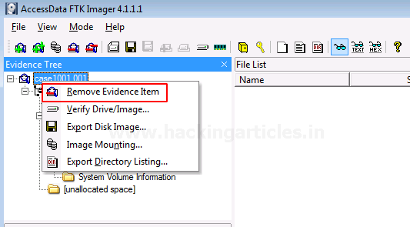
Analyzing Image Dump
To analyze other things further, we will now remove this evidence item by right-clicking on the case and click on Remove Evidence Item
30
Notes:
On board:
preservation, collection, validation, identification, analysis, interpretation, documentation and presentation

Slide 31
Capture Memory
If you’re trying to access the contents of memory from an existing system that’s running, you can use a runtime version of FTK Imager from a flash drive to access that memory.
From the File menu, you can select Capture Memory to capture data stored in memory within the system.
31
Notes:
On board:
preservation, collection, validation, identification, analysis, interpretation, documentation and presentation

Slide 32
Capture Memory
Capturing memory can be useful for a number of reasons.
For example, if TrueCrypt is running to encrypt the contents of the drive, the password could be stored in memory – if it is, Capture Memory enables you to capture the contents of memory (including the password) before it is lost.
32
Notes:
On board:
preservation, collection, validation, identification, analysis, interpretation, documentation and presentation

Slide 33
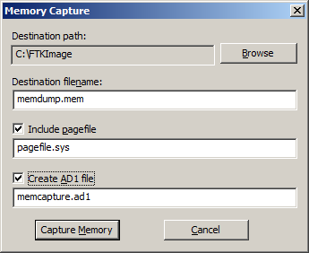
Capture Memory
Specify the destination path and filename to capture a memory to the specified file.
You can also include the contents of pagefile “.sys”, which is a Windows system file that acts as a swap file for memory; hence, it can contain useful memory information as well.
Creating an AD1 file enables you to create an AD1 image of the memory contents – then you can add it as an evidence item to review the contents.
33
Notes:
On board:
preservation, collection, validation, identification, analysis, interpretation, documentation and presentation

Slide 34
Obtain Protected Files
Windows does not allow you to copy or save live Registry files, you would have to image the hard drive and then extract the Registry files, or boot the computer from a boot disk and copy the Registry files from the inactive operating system on the drive.
From the File menu, you can select Obtain Protected Files to circumvent the Windows operating system and its file locks, thus allowing you to copy the live Registry files.
If the user allows Windows to remember his or her passwords, that information can be stored within the registry files
34
Notes:
On board:
preservation, collection, validation, identification, analysis, interpretation, documentation and presentation

Slide 35
Obtain Protected Files
Specify the destination path for the obtained files, then select the option for which files you would like to obtain.
The Minimum files for login recovery option retrieves Users, System, and SAM files from which you can recover a user’s account information.
The Password recovery and all Registry files option is more comprehensive, retrieving Users, System, SAM, NTUSER.DAT, Default, Security, Software, and Userdiff files from which you can recover account information and possible passwords to other files.
35
Notes:
On board:
preservation, collection, validation, identification, analysis, interpretation, documentation and presentation

Slide 36
Obtain Protected Files
The Security Account Manager (SAM) is a database file in Windows XP, Windows Vista, Windows 7, 8.1, 10 and 11 that stores users' passwords.
The SAM database file is stored within C:\Windows\System32\config.
All of the data within the file is encrypted.
The passwords hashes are stored in HKEY_LOCAL_MACHINE\SAM.
As the primary purpose of the SAM is to increase security, its access is restricted.
36
Notes:
On board:
preservation, collection, validation, identification, analysis, interpretation, documentation and presentation

Slide 37
Obtain Protected Files
Finally, in the directory that you have chosen for the export, you will find six files (default, SAM, SECURITY, software, system, userdiff) and the folder Users.
Default HKEY_USERS\DEFAULT
SAM HKEY_LOCALMACHINE\SAM
SECURITY HKEY_LOCALMACHINE\SECURITY
Software HKEY_LOCAL_MACHINE\SOFTWARE
System HKEY_LOCAL_MACHINE\SYSTEM
37
Notes:
On board:
preservation, collection, validation, identification, analysis, interpretation, documentation and presentation

Slide 38
Obtain Protected Files
Inside the folder Users, we can find at least two folders, default and public, containing an NTUSER.DAT file, the one that stores all user's registry settings (HKEY_CURRENT_USER).
To do this, you must launch FTK Imager and then click File→Add Evidence Item→Image file and then click on your image.
To extract Registry files you must search in the directory at the path %SystemRoot%\System32\Config, right-click on the file you need them and then select the export option.
38
Notes:
On board:
preservation, collection, validation, identification, analysis, interpretation, documentation and presentation

Slide 39
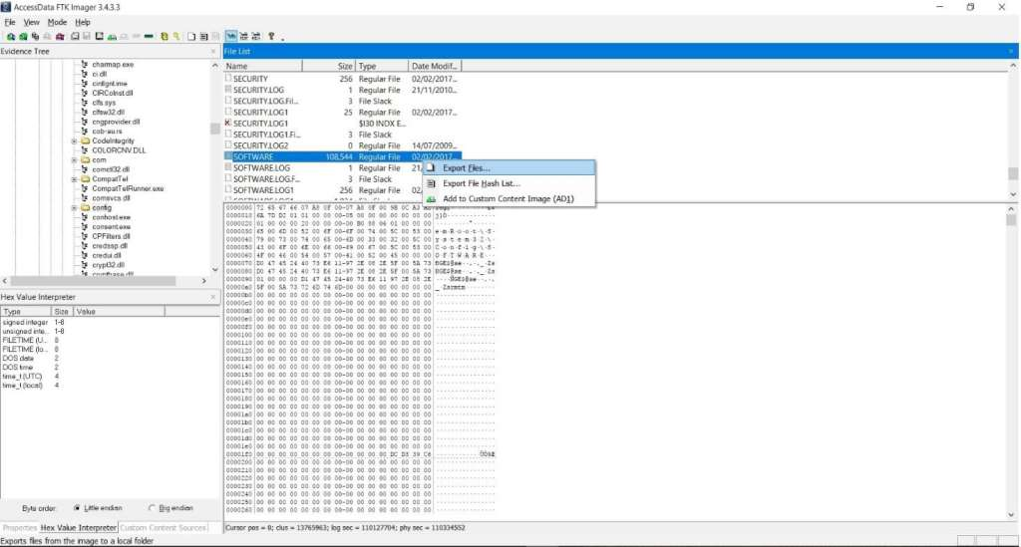
Obtain Protected Files
39
Notes:
On board:
preservation, collection, validation, identification, analysis, interpretation, documentation and presentation

Slide 40
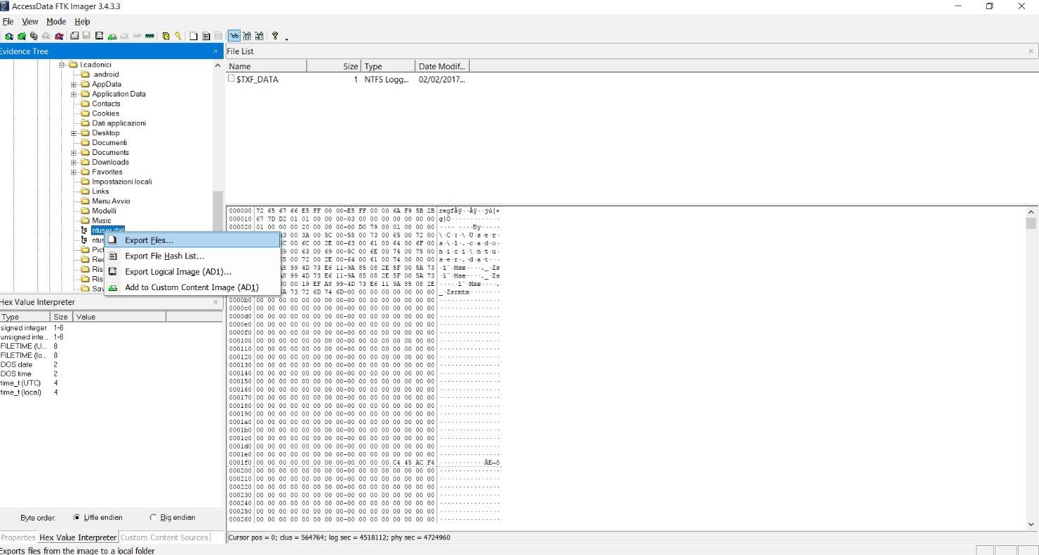
To extract the NTUSER.DAT file you must repeat the procedure inside the folder at the following path C:\Users\[USER] and then export the file related to the user’s account you’re interested in.
40
Notes:
On board:
preservation, collection, validation, identification, analysis, interpretation, documentation and presentation

Slide 41
Capturing and Examining the Registry
Installing FTK Registry Viewer
Double-click the "AccessData Registry Viewer.exe" file and install the software with the default options.
Viewing the Hive Files
Click Start. Type REGEDIT and press Enter.
In Registry Editor, navigate to
HKEY_LOCAL_MACHINE\System\CurrentControlSet\Control\HiveList
You should see a list of the files that store the Registry. For this project, we want to capture those files, and not all the other files on the disk.
41
Notes:
On board:
preservation, collection, validation, identification, analysis, interpretation, documentation and presentation

Slide 42
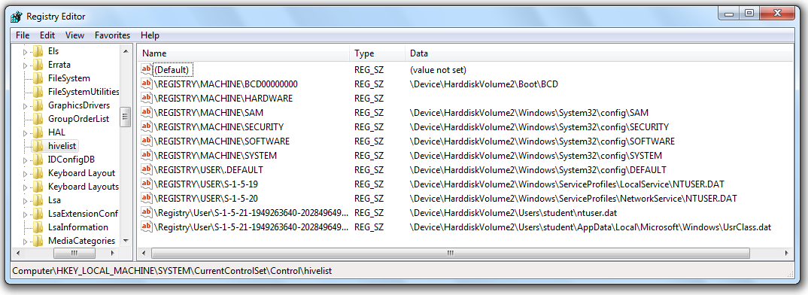
Capturing and Examining the Registry
42
Notes:
On board:
preservation, collection, validation, identification, analysis, interpretation, documentation and presentation

Slide 43
Creating a Registry Image with FTK Imager
click File, "Obtain Protected Files".
The "Obtain System Files" box opens.
Notice the Warning at the top of this box. You are obtaining data from your own computer, not from an evidence image.
At least one forensic examiner actually went to court and submitted data accidentally gathered from his own forensic workstation by ignoring this warning.
43
Notes:
On board:
preservation, collection, validation, identification, analysis, interpretation, documentation and presentation

Slide 44
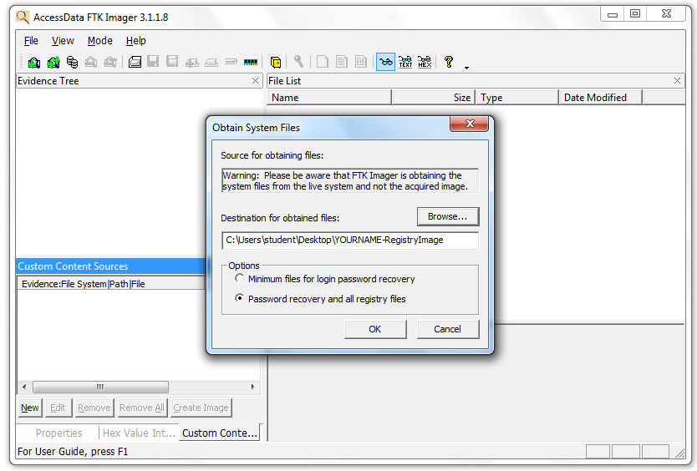
Creating a Registry Image with FTK Imager
44
Notes:
On board:
preservation, collection, validation, identification, analysis, interpretation, documentation and presentation

Slide 45
Creating a Registry Image with FTK Imager
In the "Obtain System Files" box, click the Browse button and navigate to your desktop.
Click the "Make New Folder" button, and name the new folder YOURNAME-RegistryImage.
Select the YOURNAME-RegistryImage folder and click OK.
Click the "Password recovery and all registry files" radio button, Click OK.
Wait until the process finishes. It should only take a few seconds. Close FTK Imager.
On your desktop, open the YOURNAME-RegistryImage folder.
It should contain five files and one folder. You should get used to seeing these names--they are the Hive Files
45
Notes:
On board:
preservation, collection, validation, identification, analysis, interpretation, documentation and presentation

Slide 46
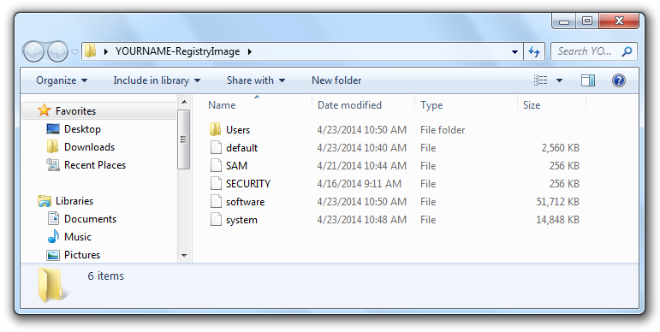
Creating a Registry Image with FTK Imager
46
Notes:
On board:
preservation, collection, validation, identification, analysis, interpretation, documentation and presentation

Slide 47
Viewing TypedURLs with Registry Viewer
TypedURLs data is a strong indicator of Web pages the user deliberately visited, although there are some complications in its interpretation, as explained in the "TypedURLs" reference at the end of this project.
On your desktop, click Start, Registry Viewer.
A box pops up saying "No security device was found." This is warning you that you are using the product in Demo mode, not the full version. Click No.
A box pops up saying "No dongle found" Click OK.
47
Notes:
On board:
preservation, collection, validation, identification, analysis, interpretation, documentation and presentation

Slide 48
Viewing TypedURLs with Registry Viewer
In Registry Viewer, click File, Open. Navigate to your Desktop, and open this file:
YOURNAME-RegistryImage\Users\Student\NTUSER.DAT
Registry Viewer is similar to REGEDIT. In the left pane, navigate to
NTUSER.DAT\Software\Microsoft\Internet Explorer\TypedURLs
48
Notes:
On board:
preservation, collection, validation, identification, analysis, interpretation, documentation and presentation

Slide 49
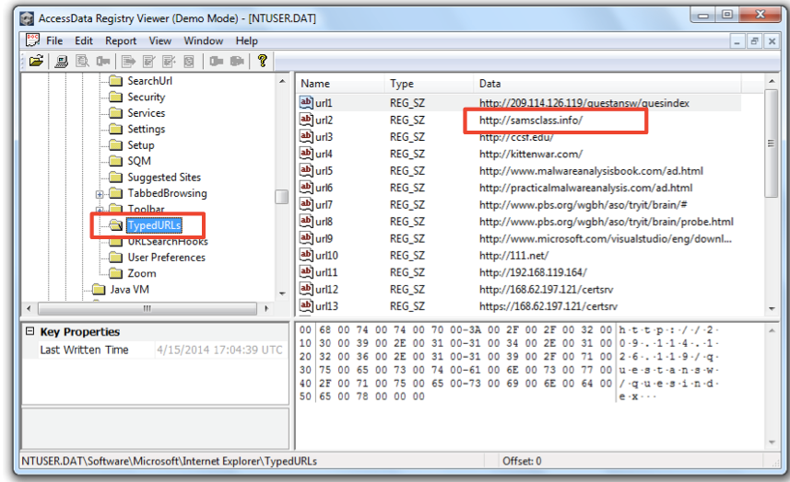
Viewing TypedURLs with Registry Viewer
The right pane should now show the URLS that have been visited, as shown below:
49
Notes:
On board:
preservation, collection, validation, identification, analysis, interpretation, documentation and presentation

Slide 50
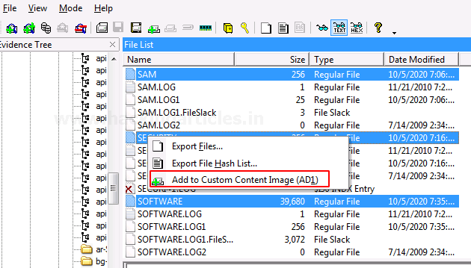
Custom Content Image with AD Encryption
FTK imager has a feature that allows it to encrypt files of a particular type according to the requirement of the examiner. Click on the files that you want to add to the custom content Image along with AD encryption.
50
Notes:
On board:
preservation, collection, validation, identification, analysis, interpretation, documentation and presentation

Slide 51
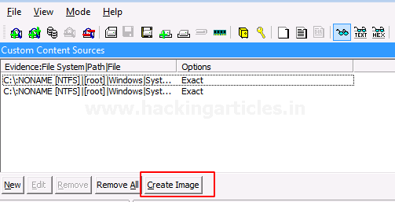
Custom Content Image with AD Encryption
All the selected files will be displayed in a new window and then click on Create Image to proceed.
51
Notes:
On board:
preservation, collection, validation, identification, analysis, interpretation, documentation and presentation

Slide 52
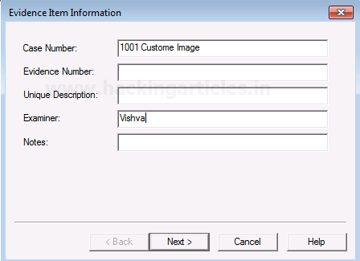
Custom Content Image with AD Encryption
Fill in the required details for the evidence that is to be created.
52
Notes:
On board:
preservation, collection, validation, identification, analysis, interpretation, documentation and presentation

Slide 53
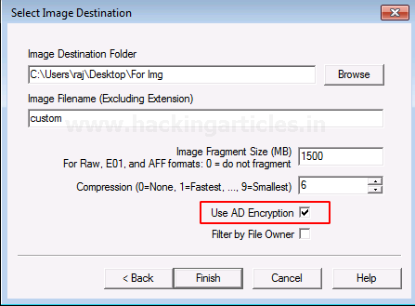
Custom Content Image with AD Encryption
Now add the destination of the image file that is to be created, name the image file and then check the box with AD encryption, and then click on Finish.
53
Notes:
On board:
preservation, collection, validation, identification, analysis, interpretation, documentation and presentation

Slide 54
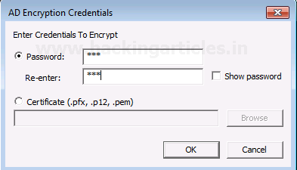
Custom Content Image with AD Encryption
A new window will pop-up to encrypt the image, Now renter and re-enter the password that you want to add for your image.
54
Notes:
On board:
preservation, collection, validation, identification, analysis, interpretation, documentation and presentation

Slide 55
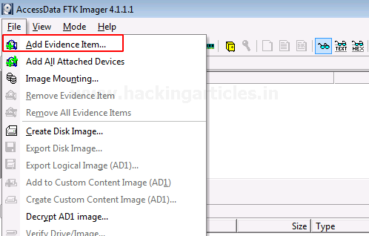
Custom Content Image with AD Encryption
Now to see the encrypted files, click on File> Add Evidence Item…
55
Notes:
On board:
preservation, collection, validation, identification, analysis, interpretation, documentation and presentation

Slide 56
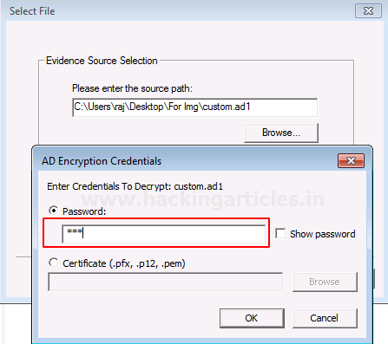
Custom Content Image with AD Encryption
The window to decrypt the encrypted files will appear once you add the file source. Enter the password and click OK.
56
Notes:
On board:
preservation, collection, validation, identification, analysis, interpretation, documentation and presentation

Slide 57
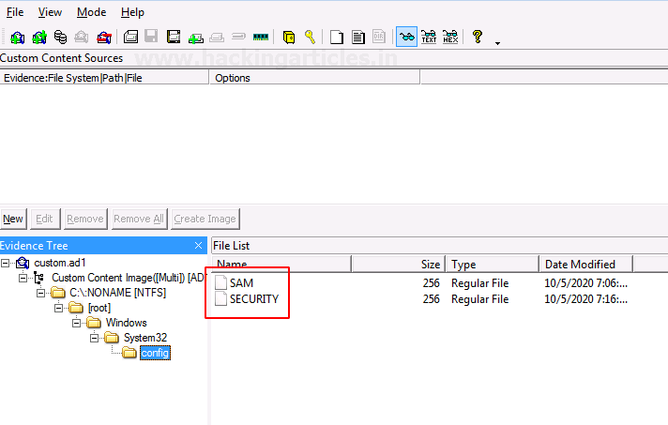
Custom Content Image with AD Encryption
You will now see the two encrypted files on entering the valid passwords.
57
Notes:
On board:
preservation, collection, validation, identification, analysis, interpretation, documentation and presentation

Slide 58
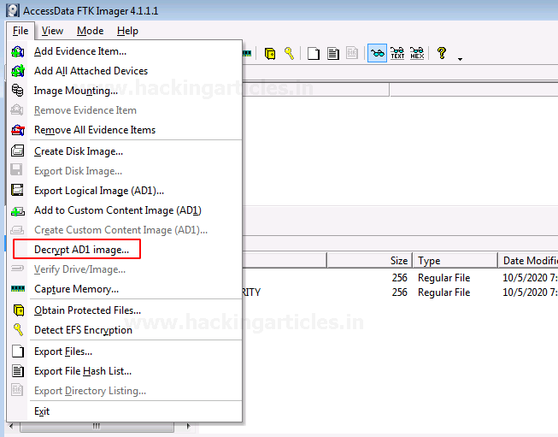
Decrypt AD1 Image
To decrypt the custom content image, click on File> Decrypt AD1 Image.
58
Notes:
On board:
preservation, collection, validation, identification, analysis, interpretation, documentation and presentation

Slide 59
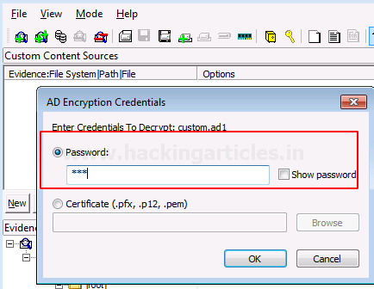
Decrypt AD1 Image
Now you need to enter the password for the image file that was encrypted and click on Ok.
59
Notes:
On board:
preservation, collection, validation, identification, analysis, interpretation, documentation and presentation

Slide 60
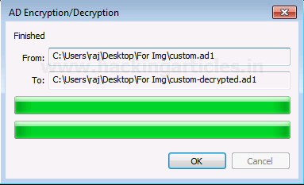
Decrypt AD1 Image
Now, wait for a few minutes till the decrypted image is created.
60
Notes:
On board:
preservation, collection, validation, identification, analysis, interpretation, documentation and presentation

Slide 61
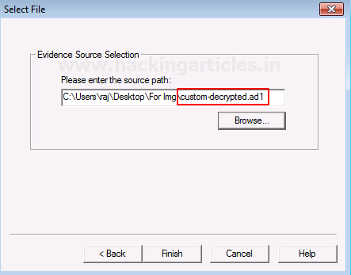
Decrypt AD1 Image
To view the decrypted custom content image, add the path of the decrypted file and click on Finish.
61
Notes:
On board:
preservation, collection, validation, identification, analysis, interpretation, documentation and presentation

Slide 62
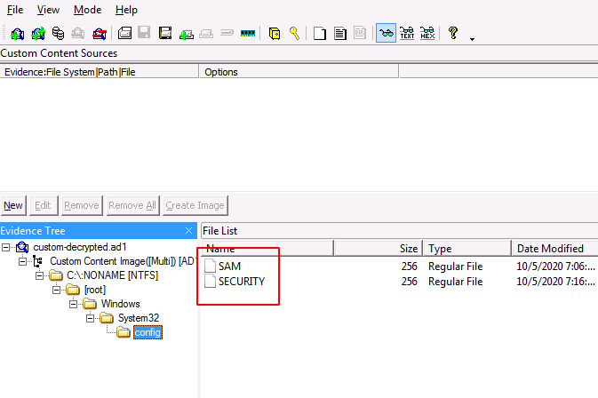
Decrypt AD1 Image
You will now be able to see the encrypted files by using the correct password to decrypt it.
62
Notes:
On board:
preservation, collection, validation, identification, analysis, interpretation, documentation and presentation

